Slide 1
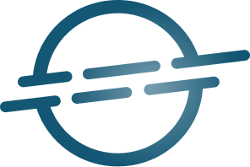

Spotify Data Governance
Data Governance and Strategy

Slide 2
Context
Tasks
Spotify: world leading audio streaming platform
Assess current data maturity of Spotify and identify key challenges
Manages a vast and complex data ecosystem
Propose a data governance plan for Spotify
user interactions, subscription data, content metadata, ...
Propose an implementation for the governance framework
Growing needs demand a robust data governance framework
Present the work to stakeholders

Slide 3
Spotify Data Landscape

Slide 4
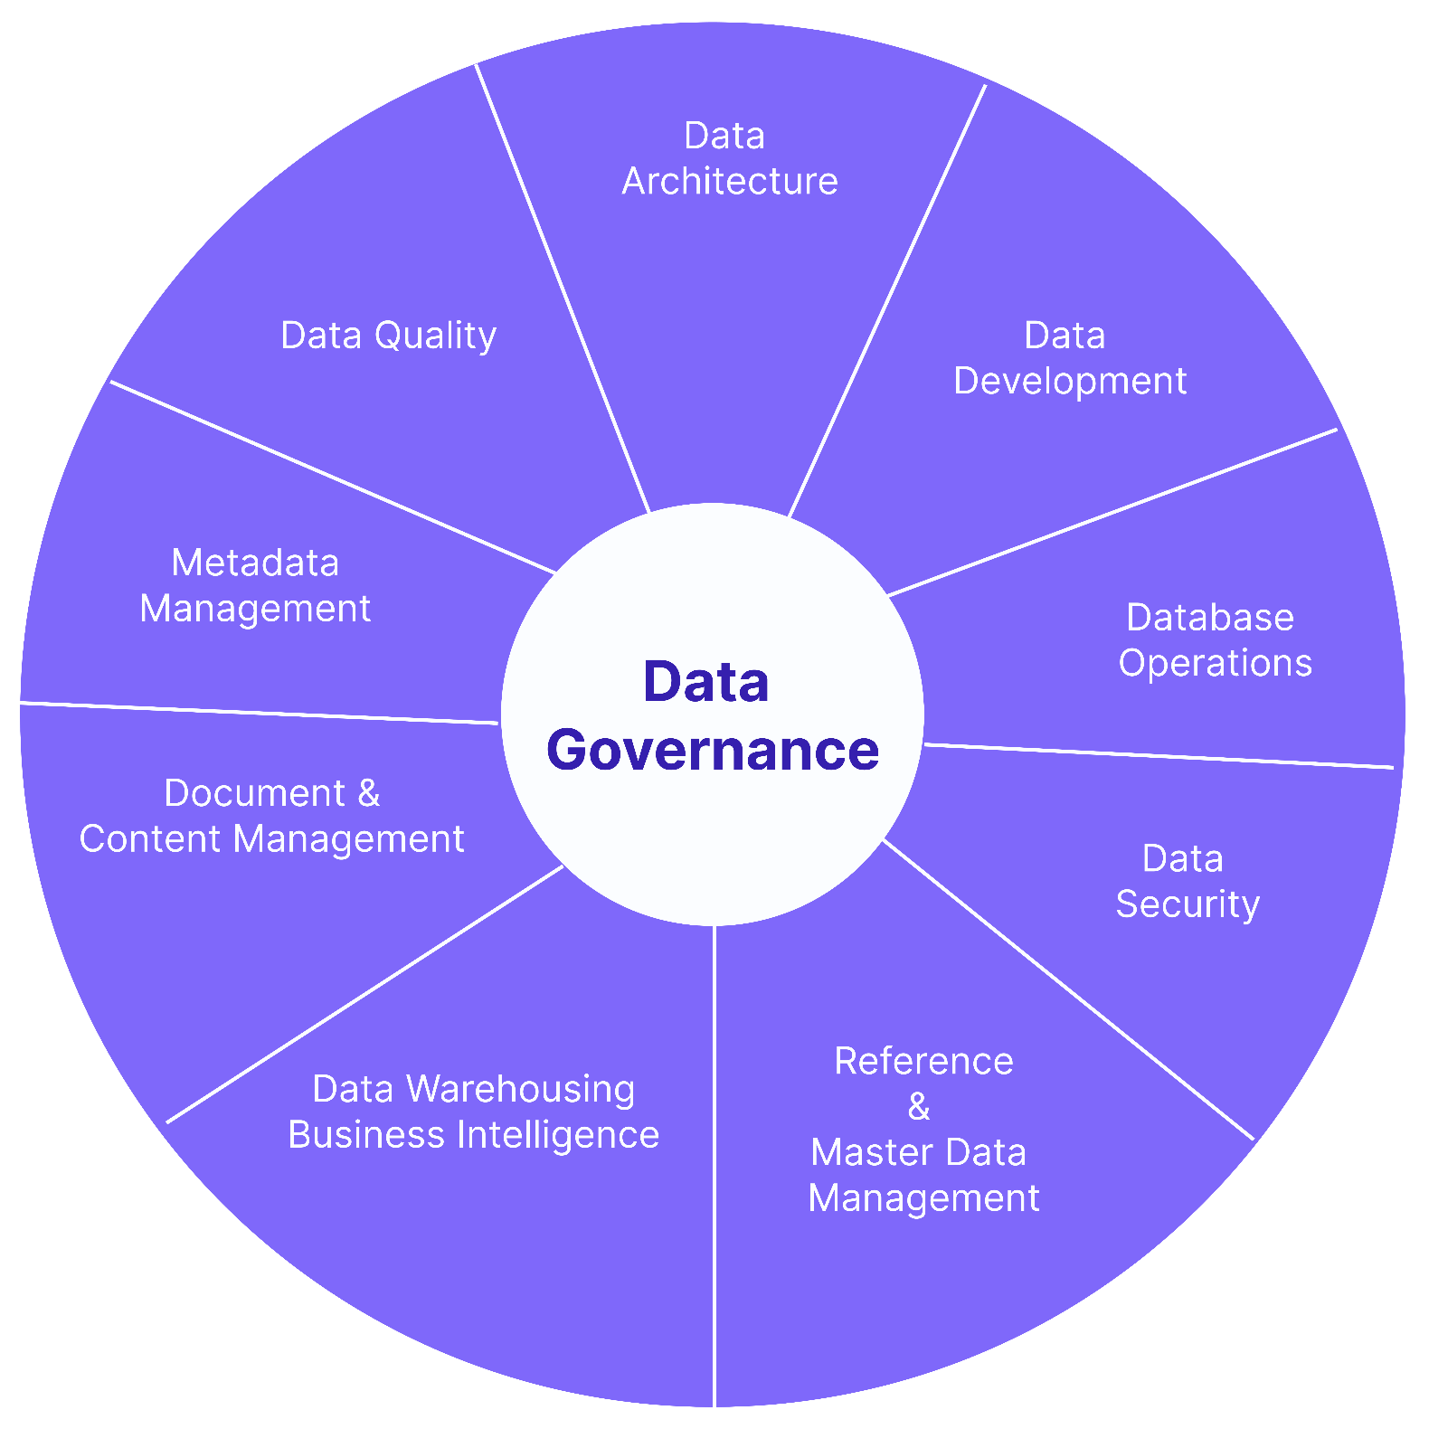
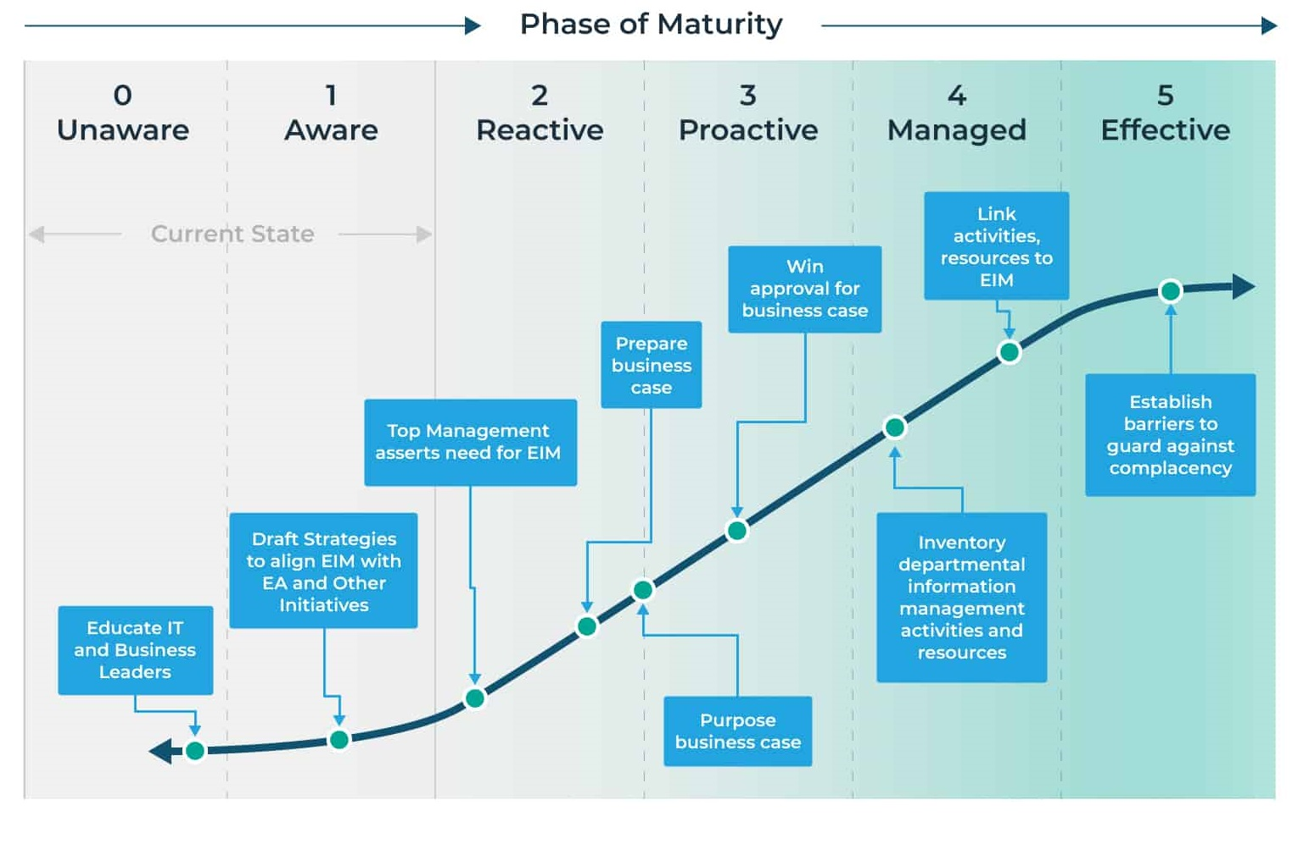
Data maturity assessment
DMBoK data management framework
Gartner data maturity scale

Slide 5
Data maturity assessment
Data silos and fragmentation
High integrity, performance and reliabilty
Normalized schema (3NF)
Low redundancy, high consistency
ACID properties
Atomicity, Consistency, Isolation, Durability
Propagate downstream through Change Data Captures (CDC)
Holds sensitive information
- !!!

Slide 6
Key Challenges
Data silos and fragmentation
Access and integration barriers
Legacy data handling by independent departments. Needs a unified data view.
Disconnected systems slow down data access. Need a unified data integration strategy.
Regulatory compliance complexity
User privacy and trust
Navigate in rapidly evolving regulations across 180+ countries. Need dynamic strategy and stronger ovesight.
Increased user awareness of data rights. Requires better consent management and anonymization protocols..
Low metadata quality
Weak data culture
Metadata inconsistently applied to various products (e.g. podcast and songs). Impacts systems such as recommendation engines.
Limited and non-unified data literacy and governance awareness.

Slide 7
Data Governance Framework

Slide 8
Data Governance Principles
Accountability
Compliance
Assign clear data ownership and stewardship across teams.
Ensure compliance with regulations (GDPR, CCPA, etc).
Transparency
Ethical Use
Data usage by Spotify must be clear to users.
Commit to responsible and privacy-centered data use.
Data Security
Protect sensitive data, safeguard against breaches.
User Rights
Data Quality
Provide tools allowing for a fine-grained control of their data by users.
Ensure data accuracy, consistency and completeness.
Continuous Improvement
Data Minimization
Regularly review and adapt governance practices.
Collect and retain only necessary data.

Slide 9
Regulatory Compliance
Requirement | Regulation | Implementation
Data processing principles | GDPR | Transparent, user-friendly notices in every market
User Rights and Consent Management | GDPR/CCPA | Portal for access, deletion, and correction requests ; consent banners, opt-in/opt-out options for cookies and analytics
Data Breach Notification | GDPR | Incident response procedure and breach dashboard overseen by DPO
Secure and Monitor Network & Systems | PCI-DSS | Implement security measures such as firewalls ; assess security through pentesting, ensure proper logging
Protect and Control Access to Data | PCI-DSS | Setup encryption and secure storage ; define access rules for the different data domains and limit access authorized personnel
Vulnerability Management Program | PCI-DSS | Perform regular security audits, ensure systems are up-to-date
Information Security Policy | PCI-DSS | Create and maintain a definite information security policy, ensure regular training of the teams

Slide 10
Roles and Responsibilities
Role | Key responsibilities
Chief Data Officer (CDO) | Leads data governance strategy, policy and KPIs
Data Protection Officer (DPO) | Ensures compliance with regulations (GDPR, CCPA, etc), handles breaches, data subject access requests (DSARs)
Head of Engineering | Builds systems to support secure, governed data access
Marketing Director | Uses the data to drive marketing campaigns or get insight about the platform usage
Data Stewards | Manage data definitions, quality, access control, and metadata within domains
Legal Counsel | Advises on compliance risks and regulatory interpretation
Product & Marketing Leads | Ensure responsible use of user data and accurate analytics

Slide 11
Data Governance Framework Implementation

Slide 12
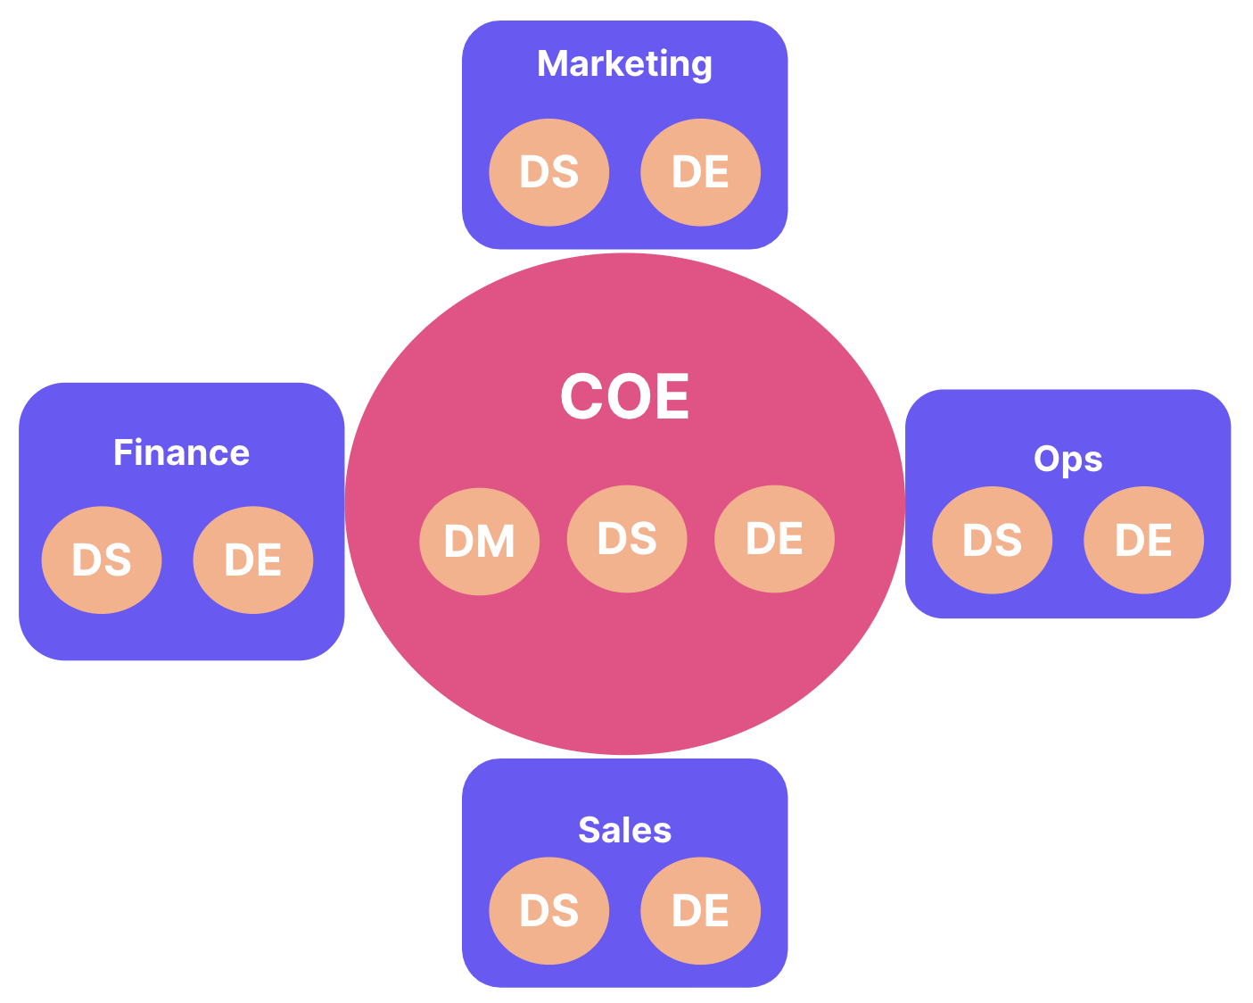
Organizational Model
Center of Excellence (CoE) Model
Central data governance team
- Lead by Chief Data Officer
- Defines standard and practices for data management
- Provides training and support to data teams
Cross-functional governance committee
- DPO, legal counsel, business leaders, etc
- Oversights data management and compliance
- Adjust governance to the needs of the company
Embedded data teams
- In each department (finance, marketing, etc)

Slide 13
Technologies and Tools
Category | Purpose | Examples
Data cataloging | Central metadata management, data discovery | Alation, Apache Atlas, Atlan, Collibra
Data quality | Automate data profiling, validation, alerts | Ataccama, Informatica Data Quality, Soda, Talend
Compliance monitoring | Manage user consent, automate DSARs | BigID, OneTrust, TrustArc, VeraSafe
Data security | Protection of sensitive user and payment data | DataGuard, Splunk, Vormetric
Lineage and integration | Track data flow across systems | Apache Atlas, Informatica

Slide 14
Pilot Implementation : Overview
User data domain
Legacy data handling by independent departments. Needs a unified data view.

Slide 15
Pilot Implementation : Timeline

Slide 16
Pilot Implementation : KPIs

Slide 17
Pilot Implementation : Overview
Goals
Deliverables
Improve data quality
Data quality report
Compliance assessment report
Ensure compliance with regulations
Integration plan
Streamline access
Risk assessment report
Mitigate risks of data misuse
Stakeholder feedback summary

Slide 18

Thanks!

